Slide 1
Irish Crime Data Analysis
Data Source: CSO (Central Statistics Office) | Garda Síochána Records

Slide 2
Understanding crime trends is critical for law enforcement planning
Historical data spans 20 years (2003-2023) across all Garda divisions
Need to identify patterns, hotspots, and temporal trends
Support evidence-based policy decisions
Introduction: The Problem

Slide 3
What We Did: Data Scope
Analyzed 181,104 recorded crime incidents
28 Garda divisions across Ireland
72 distinct offence categories
Quarterly data collection from 2003-2023
Multiple variables: location, offence type, and temporal patterns

Slide 4
How We Did It: Data Processing
Extracted data from CSO API and loaded into Postgres database
Standardized column naming conventions for consistency
Handled missing values using forward/backward fill by offence group
Detected and capped outliers using z-score methodology

Slide 5
How We Did It: Feature Engineering
Created log-transformed features for skewed count distributions
Aggregated yearly totals by offence category
Computed share of each offence type per year
Built year-over-year change metrics for trend analysis

Slide 6
Why This Analysis Matters
Identify long-term crime trends across Ireland
Detect regional hotspots and variations in crime
Support resource allocation decisions for law enforcement
Enable evidence-based policy making for public safety

Slide 7
Key Discoveries
Highest Crime Year: 2008 (296,162 incidents)
Lowest Crime Year: 2020 (185,773 incidents) - 37% decrease
Year-over-Year Growth: 2022 showed 13% increase (210,036 incidents)
Peak Crime Locations: Pearse Street, Dublin (213,708 incidents)

Slide 8
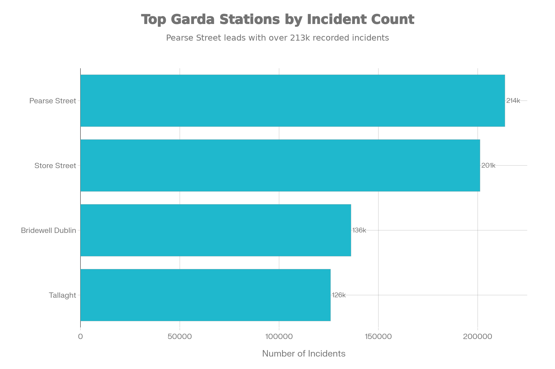
Top 4 Garda Stations By Recorded Crime Incidents

Slide 9
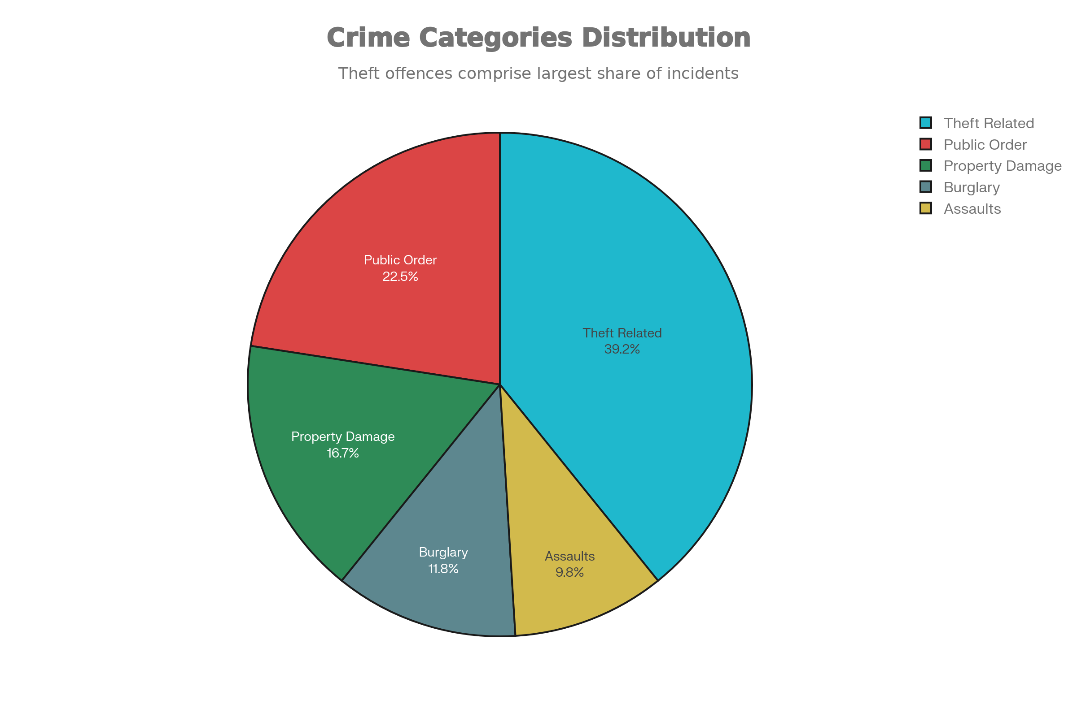
Crime Categories Distribution

Slide 10
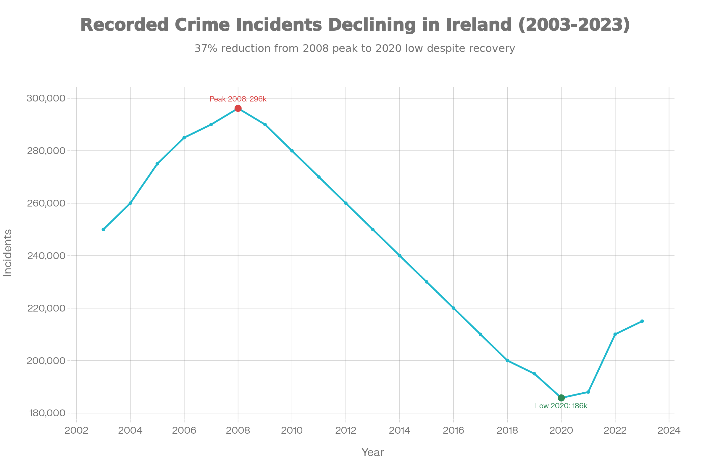
Crime Trend (2003-2023)

Slide 11
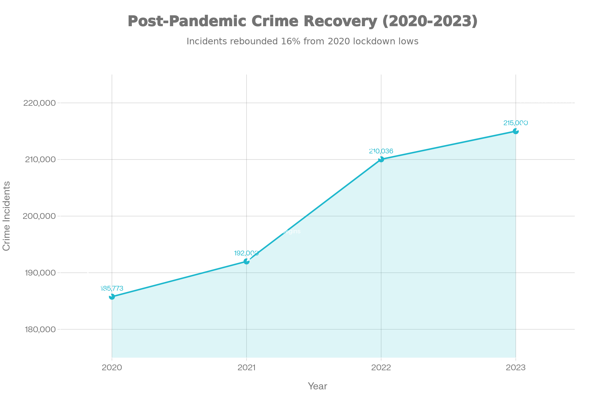
Recovery Analysis Post Pandemic

Slide 12
Theft and Related Offences: 1,566,418 incidents (40%)
Public Order & Social Code: 907,802 incidents (23%)
Damage to Property: 665,778 incidents (17%)
Burglary and Related: 461,463 incidents (12%)
Assaults & Harassment: 400,043 incidents (10%)
Offence Types: Most Common

Slide 13
Geographic Hotspots: Top 5 Stations
Pearse Street (D.M.R. South Central): 213,708 incidents
Store Street (D.M.R. North Central): 201,175 incidents
Bridewell Dublin (D.M.R. North Central): 136,214 incidents
Tallaght (D.M.R. Southern): 125,924 incidents
Blanchardstown (D.M.R. Western): 121,672 incidents

Slide 14
Conclusions
Crime peaked in 2008 (economic crisis period), declined post-2008
2020 low reflects pandemic impact on public activities
Theft dominates crime landscape (40% of all incidents)
Dublin region requires focused law enforcement resources
Recovery in 2022-2023 indicates return to normalized crime levels

